Slide 1
Journal CLUB
R3 ภูมินทร์ / อ. วิริยะ

Slide 2
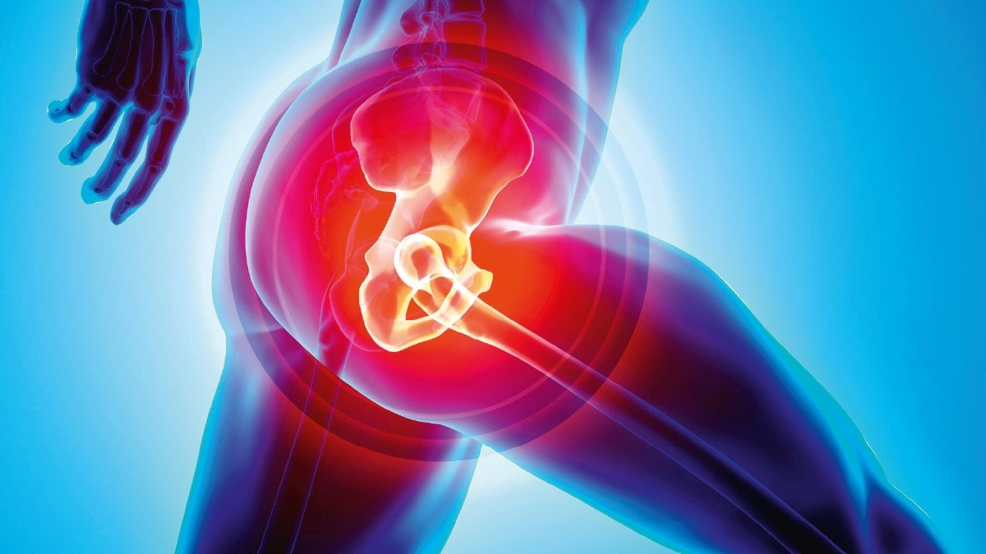
Impact of Local Infiltration Analgesia on the Quality
of Recovery After Anterior Total Hip Arthroplasty
: A Randomized, Triple-Blind, Placebo-Controlled Trial
Nicole L.Tan, MBBS, FANZCA, MClinRes,*† Robert Gotmaker, MBBS, FANZCA, MBiostat,‡
and Michael J. Barrington, MBBS, FANZCA, PhD‡§
December 2019 • Volume 129 • Number 6
www.anesthesia-analgesia.org

Slide 3
BACKGROUND
Background
number of total hip arthroplasties (THAs) performed increase
No consensus on the optimal analgesic regimen for this frequently performed procedure
1.8 million
2 .8 million
2015
2050

Slide 4
BACKGROUND
Background
Recent systematic reviews and meta-analyses reach different conclusions
all the trials included in these systematic reviews have been in the setting of a lateral or posterior surgical approach to THA
one blinded RCT has investigated effect of LIA in anterior THA → no significant difference in mean NRS for pain 4 hours after surgery

Slide 5
BACKGROUND
Background
a valid, responsive, multidimensional patient-reported quality of recovery scale is preferable to comprehensively measure clinical impact of intervention

Slide 6
BACKGROUND
Background
In this trial : LIA with 0.2% ropivacaine compared with 0.9% saline as placebo
Improvement of patient-reported quality of recovery
measured by the Quality of Recovery-15 (QoR-15) score 1 day after anterior THA

Slide 7
BACKGROUND
Methods
a single-center, parallel-group, randomized (1:1 allocation ratio), triple-blind, placebo-controlled trial
Ethical approval was granted by the Epworth HealthCare Human Research Ethics Committee

Slide 8
BACKGROUND
Methods
This trial was prospectively registered with the Australian New Zealand Clinical Trials Registry (ACTRN12615000844549, registered by principal investigator (N.L.T.), August 14, 2015)
The study was conducted at Epworth HealthCare, Richmond, a university-affiliated tertiary private hospital in metropolitan Melbourne, Australia

Slide 9
BACKGROUND
Methods
Inclusion criteria
Eligible patients were 18–85 years of age undergoing primary unilateral anterior THA for osteoarthritis with a single surgeon

Slide 10
BACKGROUND
Methods
Exclusion criteria
Patients took opioids (except for codeine), tramadol, tapentadol, or gabapentinoids in the week before surgery
allergy or contraindication to the proposed analgesic or anesthetic technique
ASA ≥ III
BMI >40 Kg/m²

Slide 11
BACKGROUND
Methods
Exclusion criteria
pregnant
undergone lower limb joint replacement in the preceding 6 months
scheduled for further surgery within 90 days
previously enrolled in this study

Slide 12
LIA Protocol and Standardized Anesthesia
Patients were randomly assigned to receive intraoperative infiltration of 0.2% ropivacaine or 0.9% saline placebo
perioperative care (LIA and anesthetic techniques, multimodal analgesia) was identical and standardized

Slide 13
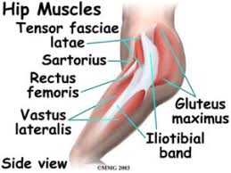
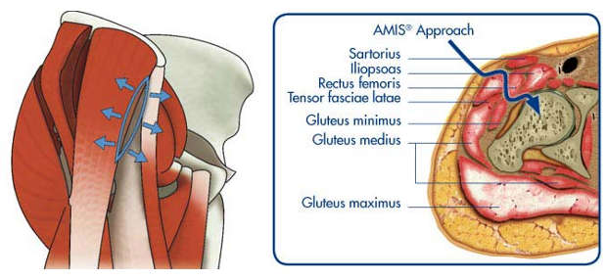
LIA Protocol and Standardized Anesthesia
The LIA injectate 2.5 mL/kg capped at 200 mL, was injected using multiple passes at each level
half the study solution was injected into the muscles in the subfascial plane

Slide 14
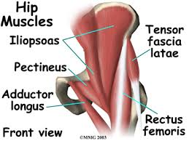
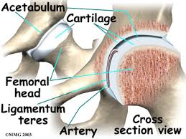
LIA Protocol and Standardized Anesthesia

Slide 15
LIA Protocol and Standardized Anesthesia
The remaining half was infiltrated with multiple passes into the subcutaneous tissues once the deep fascia was closed

Slide 16
LIA Protocol and Standardized Anesthesia
Intraoperative
Anesthesia comprised spinal anesthesia (12.5–15 mg of intrathecal bupivacaine and 15 mcg of fentanyl)
sedation (IV midazolam and propofol titrated to participant comfort)
An anterior surgical approach was used, with no wound drains or urinary catheters (unless required for urinary incontinence)

Slide 17
LIA Protocol and Standardized Anesthesia
Intraoperative
paracetamol 1 gm IV
parecoxib 40 mg IV
Dexamethasone 4 mg IV
Ondansetron 8 mg IV
tranexamic acid 1 gm IV
cefazolin 2 gm IV

Slide 18
LIA Protocol and Standardized Anesthesia
At PACU
Immediate-release oxycodone 10 mg orally
Post operative
Ondansetron 8 mg IV antiemetic prophylaxis given every 8 hours for 24 hours
IV antibiotic prophylaxis for 48 hours
daily thromboprophylaxis with low molecular weight heparin(enoxaparin) for 4 weeks postoperatively

Slide 19
LIA Protocol and Standardized Anesthesia
Post operative
IV fluid was ceased the day after surgery if oral fluid intake had commenced and the patient was hemodynamically stable
A standardized mobilization plan and discharge criteria

Slide 20
LIA Protocol and Standardized Anesthesia
Post operative
paracetamol (modified-release) 1330 mg oral every 8 hours
meloxicam 15 mg daily
oxycodone/naloxone (10/5 mg) (modified release) every 12 hours (reduced to 5/2.5 mg if patient weighed <50 kg, or increased to 20/10 mg if the patient weighed >85 kg)

Slide 21
LIA Protocol and Standardized Anesthesia
Post operative
Immediate-release oxycodone (5–10 mg) was administered every 4 hours if the pain NRS >2
Patients with pain NRS >7 were administered 25-mcg boluses of fentanyl via IV patient-controlled analgesia

Slide 22
Outcome Measures
The primary outcome measure was QoR-15 score on postoperative day (POD) 1 as close to 24 hours postoperatively as feasible, with a range of 20–26 hours
QoR-15 is a valid, reliable, and responsive multidimensional patient-reported quality of recovery scale

Slide 23
Outcome Measures
QoR-15 Scores from 15 items that assess the domains of pain, physical comfort, physical independence, emotions, and psychological support
score ranges from 0 (extremely poor recovery) to 150 (excellent recovery)
QoR-15 scores extensive psychometric testing
Recommended for use in trials assessing postoperative patient comfort

Slide 24
Outcome Measures
Secondary outcomes were pain
1. pain NRS (0: no pain, 10: worst imaginable) at rest and on movement in the past 24 hours on POD 1
2. Brief Pain Inventory (BPI severity and interference components; 0–10, 0: no pain or interference, 10: worst imaginable pain or interference) on POD 90
3. Opioid consumption was measured by total oral morphine equivalent (OME, mg/d; total dose of opioid medication in the past 24 hours) on PODs 1 and 2

Slide 25
Outcome Measures
BPI is a patient-reported measure that assesses pain and its interference with physical and emotional functioning
recommended for use in trials assessing chronic pain

Slide 26
Outcome Measures
4. Mobilization was measured by the 10-meter walk test (10MWT; time taken for the patient to walk 10 m) on POD 1.
5. Length of hospital stay was measured from commencement of anesthesia to time of discharge

Slide 27
Randomization and Blinding
A statistician prepared a computer-generated randomization schedule using random permuted blocks
Patients were allocated to receive either 0.2% ropivacaine or 0.9% saline in a 1:1 ratio, stratified by sex (1:1.5 male-to-female ratio, in accordance with the surgeon’s usual patient sex distribution)

Slide 28
Randomization and Blinding
Opaque, sealed, stapled envelopes containing
written letter “R” for 0.2% ropivacaine or “S” for 0.9% saline were placed in sequential order according to the stratified randomization schedule by a hospital pharmacist and stored in a secure office in the pharmacy department

Slide 29
Randomization and Blinding
On request, a pharmacist opened the next envelope in the stratified group, prepared and delivered the allocated study drug in identical sterile containers labeled with the patient’s details and “0.2% ropivacaine or 0.9% saline”
Allocation was concealed until after completion of statistical analysis

Slide 30
Randomization and Blinding
All patients, clinical staff (surgeon, anesthetist, other theater and ward doctors, nurses, and physiotherapists), and research personnel (enrolling nurse and statisticians) were blinded to treatment allocation
Both 0.2% ropivacaine and 0.9% saline are clear, colorless, nonviscous, odorless solutions, and are identical in appearance

Slide 31
Statistical Analysis
49 patients per group were required for an expected difference in QoR-15 of 10 points, expected standard deviation (SD) of 15 points, statistical power of 0.90, and a 2-tailed α of 0.05
After commencement of recruitment, the developers of the QoR-15 score estimated the minimal clinical important difference to be 8 points

Slide 32
Statistical Analysis
The recalculated sample size was 75 patients per group. To allow for loss to follow- up and protocol deviations, we recruited 160 patients
No interim analysis was performed, and all patients, hospital staff, and research personnel remained blinded to the allocated intervention

Slide 33
Statistical Analysis
All outcomes were analyzed on an intention-to-treat basis
compared the distributions of all continuous and discrete outcome measures using the Wilcoxon rank sum test and reported the Hodges–Lehmann median difference and robust 95% confidence intervals (CIs)

Slide 34
Statistical Analysis
The Hodges–Lehmann estimator is the median of all pairwise differences between groups and is not necessarily equal to the difference in group medians
compared categorical outcomes using Fisher exact test and reported frequencies and proportions
all tests, a P value of < 0.05 was considered significant

Slide 35
Statistical Analysis
Continuous or discrete baseline characteristics were described using median and interquartile range (IQR) or mean and SD as appropriate
Categorical data were summarized with frequencies and proportions

Slide 36
Statistical Analysis
Differences between baseline characteristics were assessed by standardized differences
standardized difference is the difference in group means or proportions scaled by the pooled SD

Slide 37
Statistical Analysis
Differences <0.1 in prognostic baseline covariates were considered insignificant
differences <0.2 were considered small
All calculations were performed in Stata Version 14 (StataCorp, College Station, TX)

Slide 38
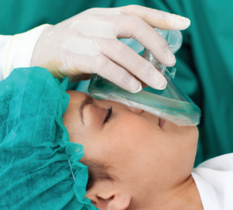
RESULTS

Slide 39
BACKGROUND
Results
160 patients were randomized between April 20, 2016, and August 28, 2018
6 patients were withdrawn, and complete outcome data were not available for 2 patients
resulting in the primary outcome data being analyzed in 152 patients (Figure 1)
The groups were similar in baseline patient and procedural characteristics (Table 1).

Slide 40
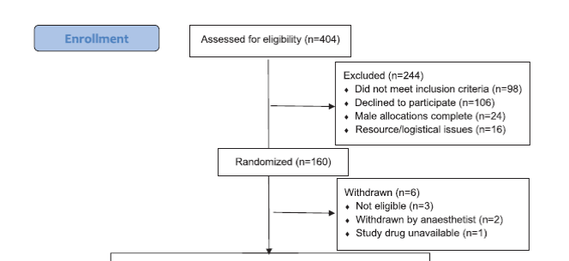

Slide 41
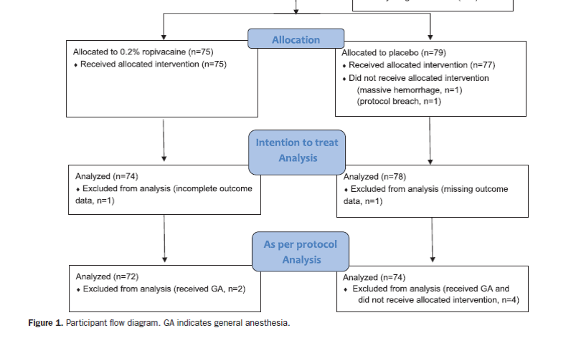

Slide 42
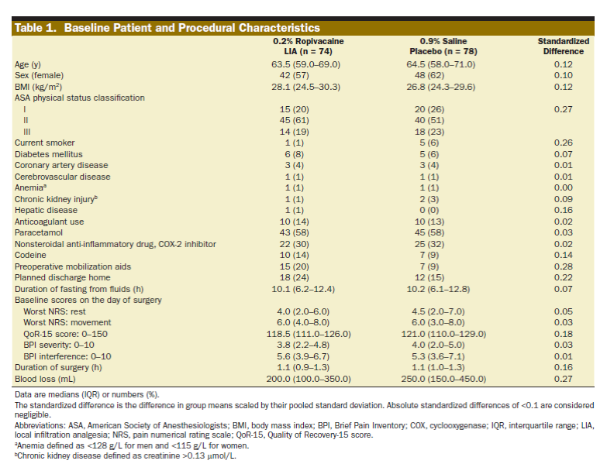

Slide 43
BACKGROUND
Results
Primary Outcome
The median (IQR) QoR-15 score on POD 1 of ropivacaine group was 119.5 (102–124) compared with placebo group was 115 (98–126) (Figure 2)
The median difference of 2 (95% CI, −4 to 7; P = .56) was not statistically or clinically significant.

Slide 44
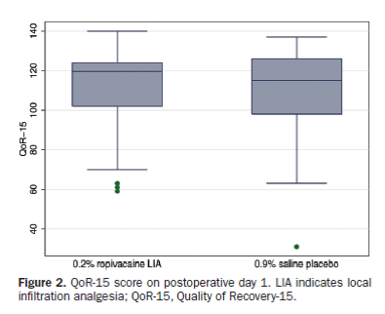

Slide 45
BACKGROUND
Results
Primary Outcome
Median differences of each domain of QoR-15 were not different (Table 2)

Slide 46
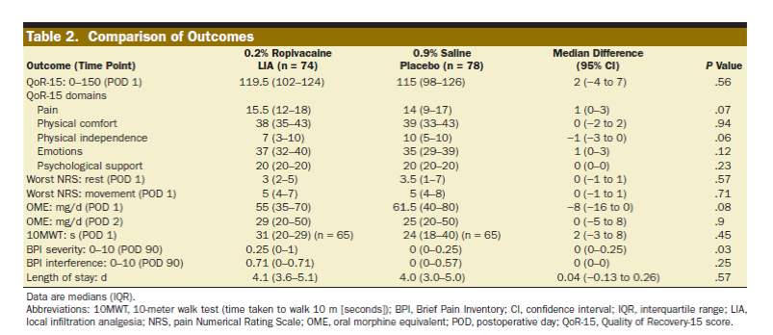

Slide 47
BACKGROUND
Results
Primary Outcome
A secondary as-per-protocol sensitivity analysis included 146 patients who received spinal anesthesia without general anesthesia and the allocated intervention (2 patients were excluded in the ropivacaine group, and 4 patients were excluded in the placebo group)
The results were similar
Patients 152 → 146.

Slide 48
BACKGROUND
Results
Primary Outcome
Median (IQR) QoR-15 score on POD 1 of ropivacaine group was 119.5 (102–124.5) compared with the placebo group, which had a median (IQR) of 114.5 (98–126).
The median difference of 2 (95% CI, - 3 to 8; P = .48) was not statistically or clinically significant

Slide 49
BACKGROUND
Results
Secondary Outcome
Worst pain NRS at rest and on movement on POD 1 (Figure 3), OMEs on PODs 1 and 2, 10MWT on POD 1, BPI interference on POD 90, and length of stay (Table 2)
Not different

Slide 50
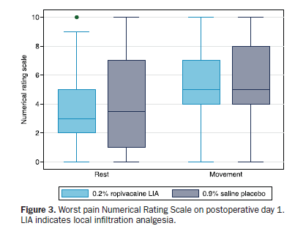

Slide 51
BACKGROUND
Results
Secondary Outcome
The median (IQR) BPI severity at POD 90 in the ropivacaine group was 0.25 (0–1), compared with 0 (0–0.25) in the placebo group
This median difference was statistically significant (P = .03) → not clinically significant

Slide 52
BACKGROUND
Results
Secondary Outcome
The number (proportion) of patients using any opioid analgesia in the ropivacaine and placebo groups were 11 (15%) and 14 (18%) at POD 30, and 3 (4%) and 2 (3%) at POD 90
The respective risk ratios were 0.83 (95% CI, 0.40–1.7; P = .67) and 1.6 (95% CI, 0.27–9.2; P = .61)

Slide 53
BACKGROUND
Results
Adverse Event
There were no local anesthetic toxicity complications
3 patients in ropivacaine group had superficial wound infections requiring antibiotic treatment
1 patient in each group had a prosthesis infection requiring antibiotic treatment and joint washout

Slide 54
DISCUSSION

Slide 55
Discussion
no significant difference in the primary outcome measure, QoR-15 score on POD 1, in patients receiving 0.2% ropivacaine LIA compared with 0.9% saline as placebo

Slide 56
Discussion
no clinically significant differences between groups for secondary outcome
- worst pain NRS at rest or with movement
- opioid consumption, early mobilization
- pain severity or interference on POD 90
- length of hospital stay

Slide 57
Discussion
Our findings are consistent with other trial of LIA in anterior THA → no benefit of LIA compared with placebo in pain scores at 4 hours post-op, or opioid consumption up to 2 days post-op

Slide 58
Discussion
Uniquely, we used a multidimensional patient-reported outcome measure of recovery for the primary end point of the study (assessment of pain, physical comfort, and physical independence )
In a recent systematic review, QoR-15 fulfilled all criteria for measurement properties of a patient reported outcome (internal consistency,reliability, measurement error, content, construct validity, criterion validity, and responsiveness

Slide 59
Discussion
LIA was introduced into clinical practice after publication of a large case series
trials that followed compared LIA with alternative analgesic techniques such as epidural analgesia36 and intrathecal morphine → LIA provided comparable analgesic benefit

Slide 60
Discussion
Comparisons of multidrug LIA and placebo → reduction in pain scores and opioid consumption
however, the methodology was suboptimal because systemic analgesia in control groups did not include NSAIDs or steroids
Other studies did not use a placebo and therefore were unblinded

Slide 61
Discussion
Rigorously conducted blinded RCTs have found that LIA is not superior to placebo in reducing pain scores or analgesic consumption after non – anterior THA
may be because there is limited ability of an analgesic intervention to reduce pain scores in an inherently less painful procedure (anterior THA compared with posterior or lateral THA)

Slide 62
Discussion
Another possibility is that any potential effect of LIA was short lived and therefore not detected on POD 1. If it exists, such a short-lived effect has questionable benefit
We chose QoR-15 because we wished for a comprehensive measure of recovery
The single-surgeon design of this study may limit generalizability of the findings

Slide 63
Discussion
The findings of our study may not generalize to non-anterior THA approaches with larger incisions and different dissection techniques, or to LIA injectates other than plain 0.2% ropivacaine
Our findings may also not be applicable in institutions outside Australia with different clinical pathways

Slide 64
Discussion
our study population’s opioid consumption in the first 24 hours postoperatively was greater than that of study populations that had a spinal anesthetic with sedation and lower than that of study populations that had a general anesthetic

Slide 65
CONCLUSION

Slide 66
Conclusion
LIA with 0.2% ropivacaine when compared with 0.9% saline as placebo did not improve quality of recovery 1 day after anterior THA
The results of our study strengthen the evidence that LIA is not beneficial after anterior THA

Slide 67
CLINICAL APPRAISAL LIST

Slide 68
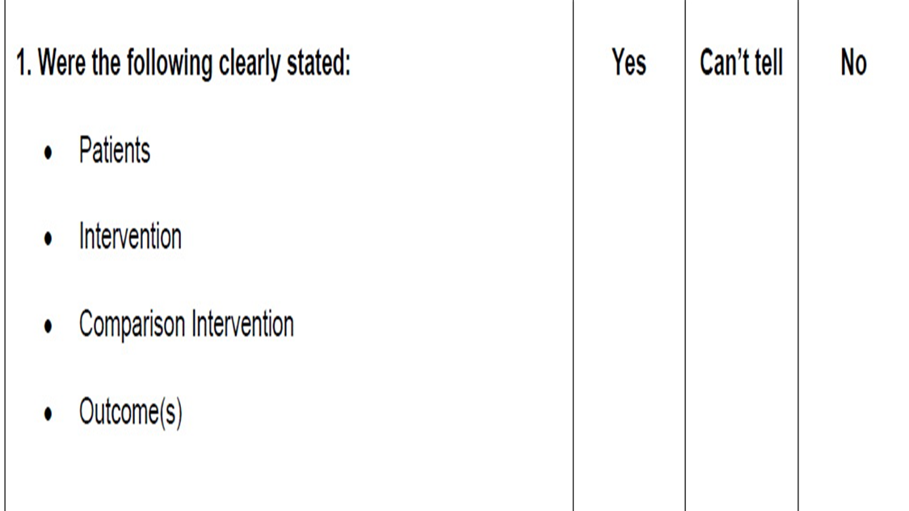
Critical Appraisal : RCT
Does this study address a clear question ?

Slide 69
Critical Appraisal : RCT
Are the results of this single trial valid ?

Slide 70
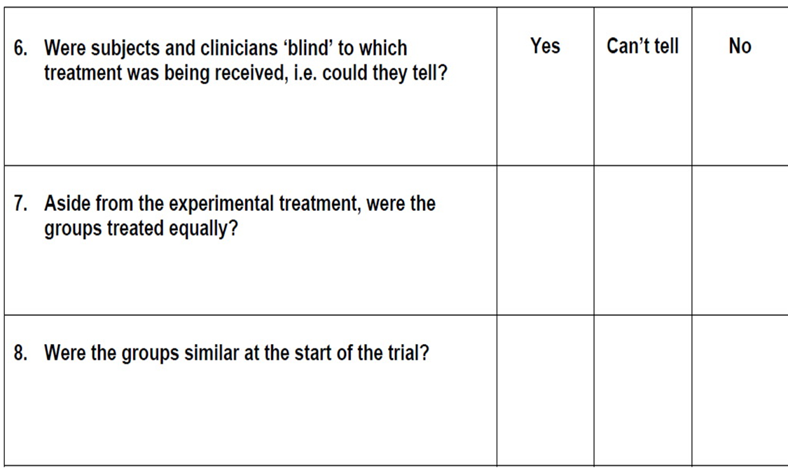
Critical Appraisal : RCT
Are the results of this single trial valid?

Slide 71
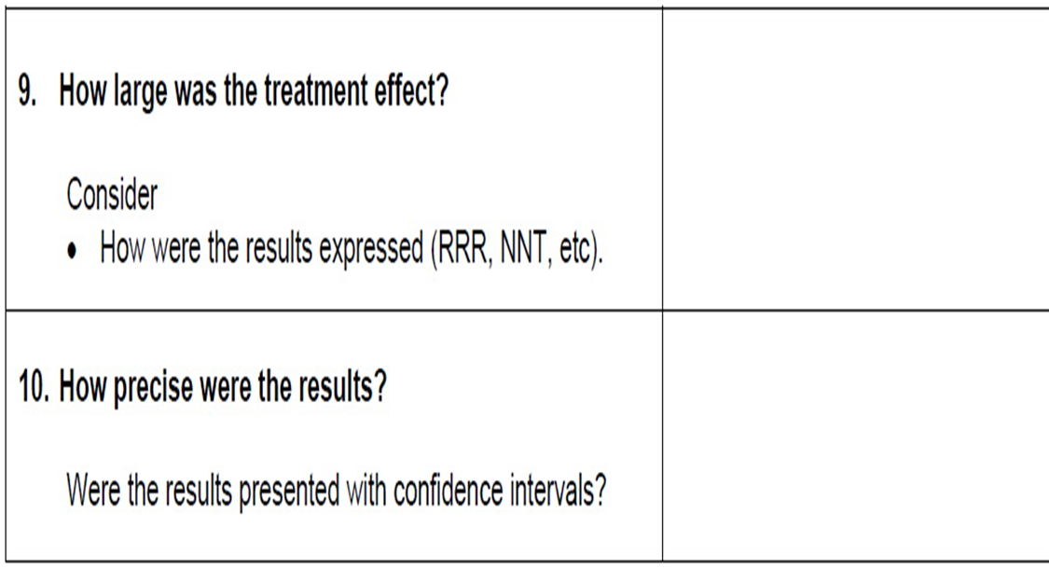
Critical Appraisal : RCT
What were the results?

Slide 72
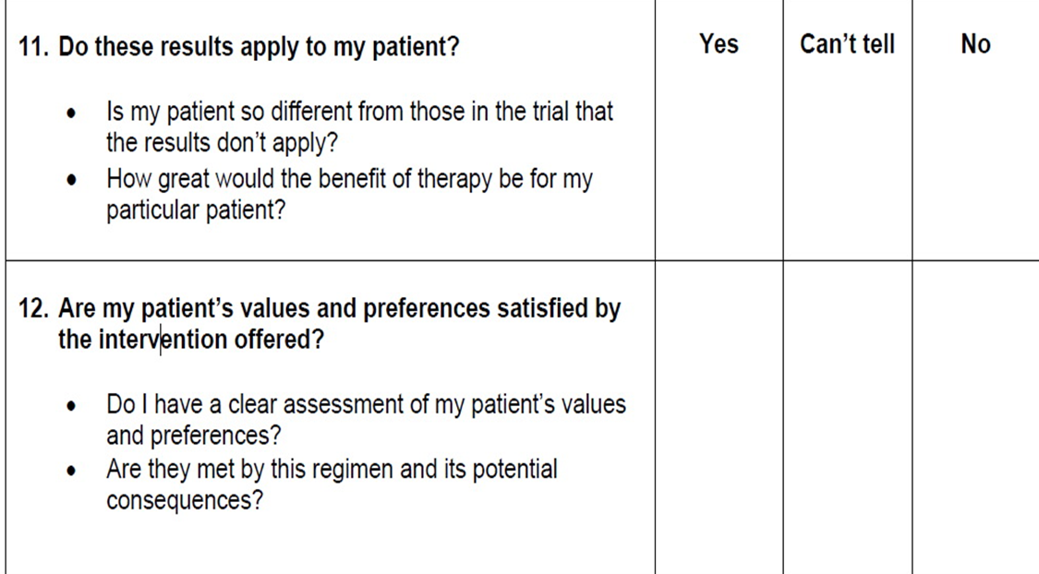
Critical Appraisal : RCT
Can I apply these valid, important results to my patients?

